Slide 1
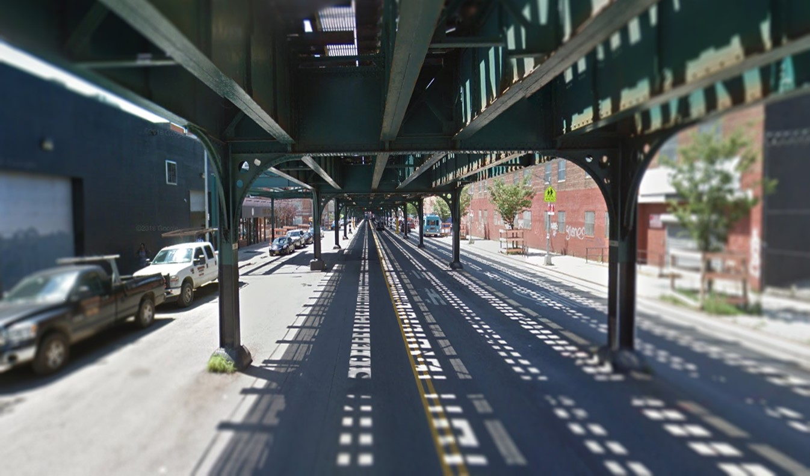
Southern Boulevard TRANSPORTATION ISSUES & OPPORTUNITIES

Slide 2
Introduction
Gather Background Information
Share Ideas with Borough Office + Capital Planning + Urban Design
Implementations
Identify Issues and Opportunities
Develop Capital Strategies with Capital Agencies
Next step: collect data and further investigate the identified issues to develop recommendations

Slide 3
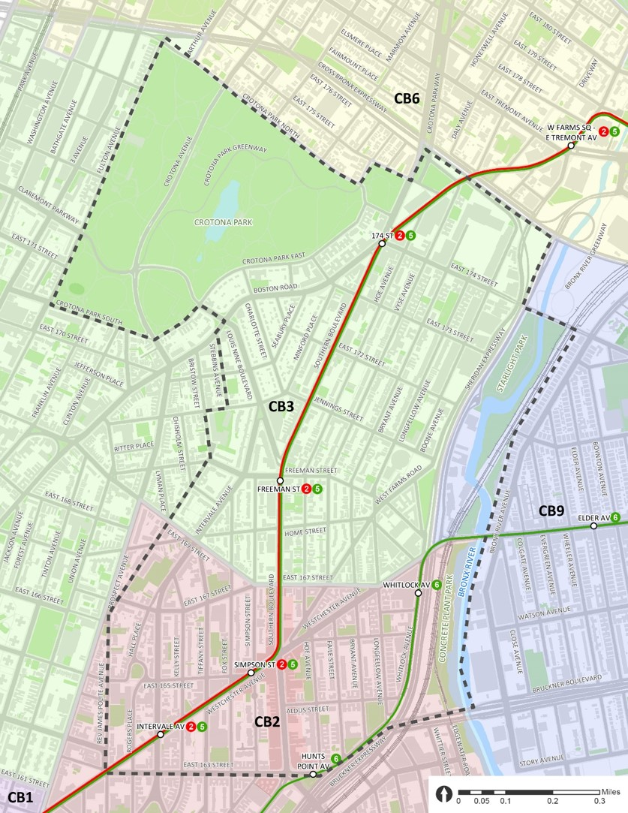
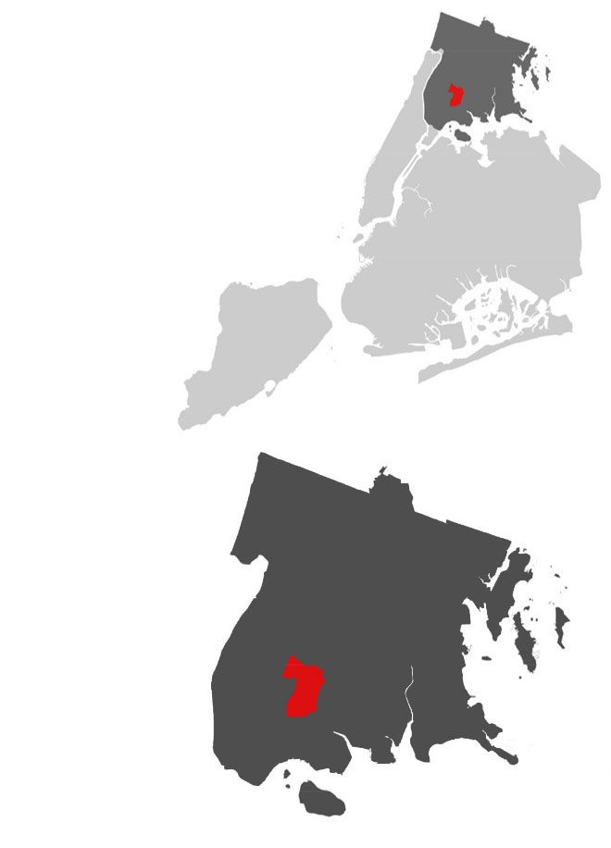
Background
3 Community Districts (CB3, CB2, CB9)
58,814 Residents
1.09 sq. mi.
45,934 people per sq. mi. (NYC: 27,000)
Predominantly Hispanic or Black/African American Non-Hispanic
Median Income: $24,125 (Bronx: $34,388; NYC: $52,259)
NYC
Bronx
Source: 2010 Census

Slide 4
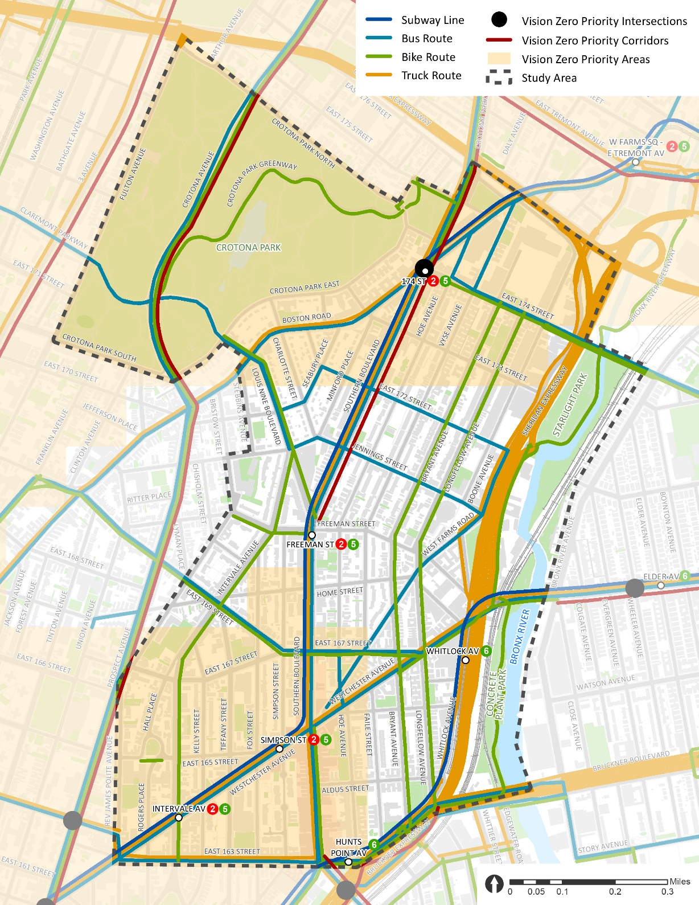
Transportation Resources and Open Space
Transit Access
3 elevated subway lines and 6 subway stations
10 bus routes (1 future SBS along 163 St) and 95 bus stops
3 major transit hubs: Simpson St, Hunts Point Ave, and West Farms Sq (just outside of the study area)
21 bus stops under the els
Bicycle Network
1.7 miles greenways; 4 miles bicycle lanes; 0.6 mile shared lane; 1.7 miles signed routes
Truck Routes
3 through truck routes; 5 local truck routes
Vision Zero
1 Vision Zero Priority Intersection (Southern Blvd @ Boston Rd @ 174 St)
2 Vision Zero Priority Corridors (Crotona Ave + Southern Blvd)
Open Space
Crotona Park (127.5 acres; ‘Central Park’ of the South Bronx; 3.3-acre lake; largest pool in the Bronx; 20 tennis courts)
Bronx River parks (Starlight Park + Concrete Plant Park)
Sheridan Expressway “Boulevardization”
Sheridan Expressway is planned to be transformed into a neighborhood boulevard to better connect the neighborhood and the Bronx River waterfront with three planned crossings*
Crotona Park
Planned Crossing
Planned Crossing
Planned Crossing
Sheridan Expy
Bronx River
*Sheridan-Hunts Point Land Use and Transportation Study: http://www1.nyc.gov/site/planning/plans/sheridan-hunts-point/sheridan-hunts-point.page

Slide 5
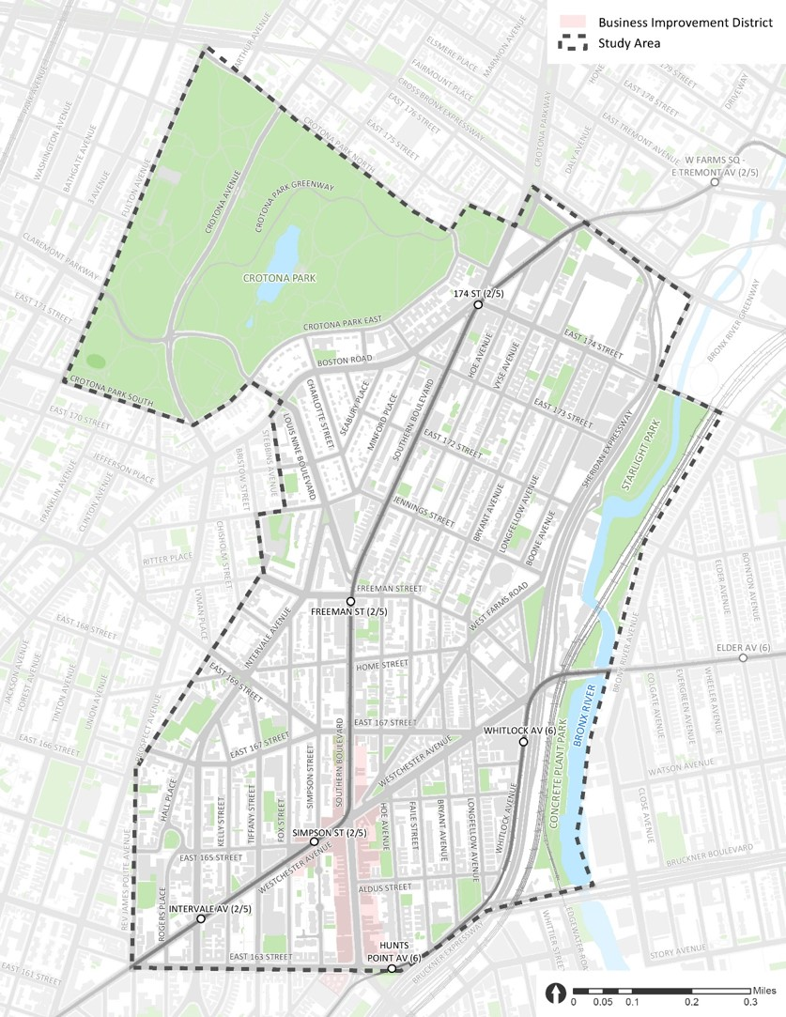
Issues & Opportunities
Under the Els
Crotona Park
Connectivity
Louis Nine Blvd Connection
174 St Connection
Crotona Ave @ Claremont Pkwy
Crotona Park East
Pedestrian Realm
Southern Blvd Retail Corridor
Simpson St Triangle
Monsignor Del Valle Square
Horseshoe Park Triangle
Westchester Ave
163 St / Rev James A Polite Ave
Southern Blvd
West Farms Rd Bus Terminal
Hoe Ave
Longfellow Ave / 167 St
Whitlock Ave
1
5
3
4
2
2
6
5
3
4
2
4
2
1
1
3

Slide 6
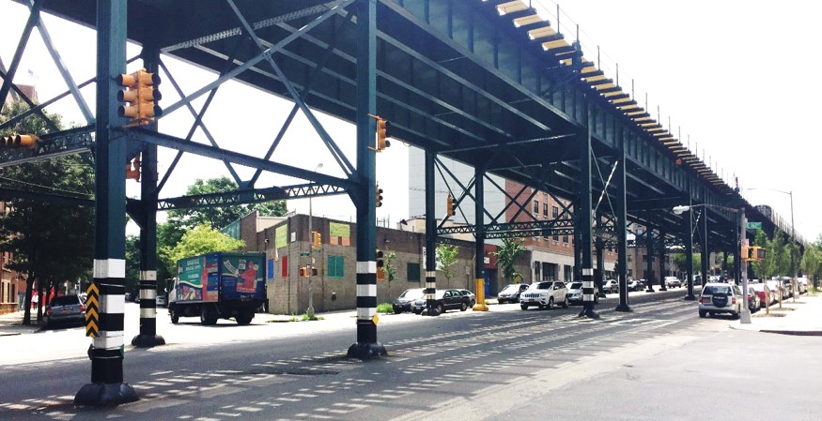
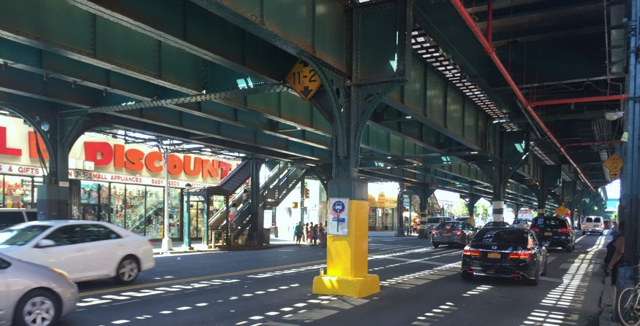
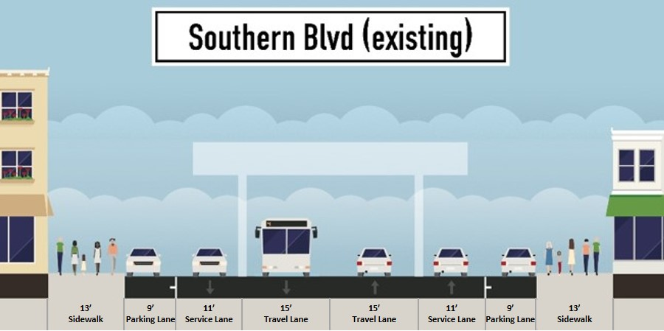
Under the Els
Background
Height varies dramatically
1 travel lane + 1 service lane + 1 parking lane
Yellow columns ~ bus stops
~3 to 4 stories
Travel Lane
Service Lane
Parking Lane
Westchester Ave @ 163 St
~1 to 2 stories
Bus Stop with Yellow Column
Westchester Ave @ Simpson St

Slide 7
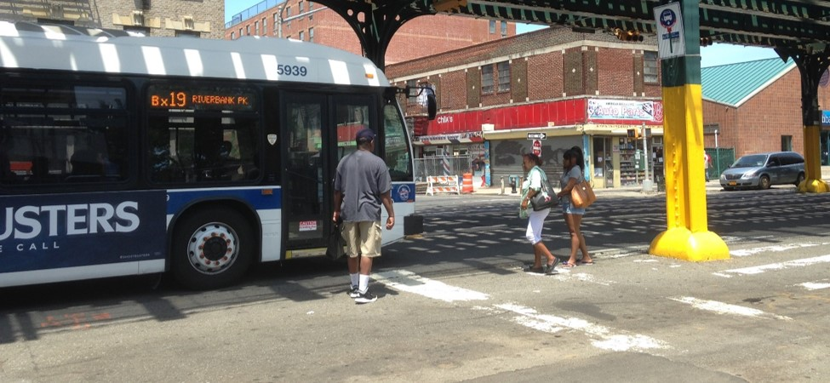
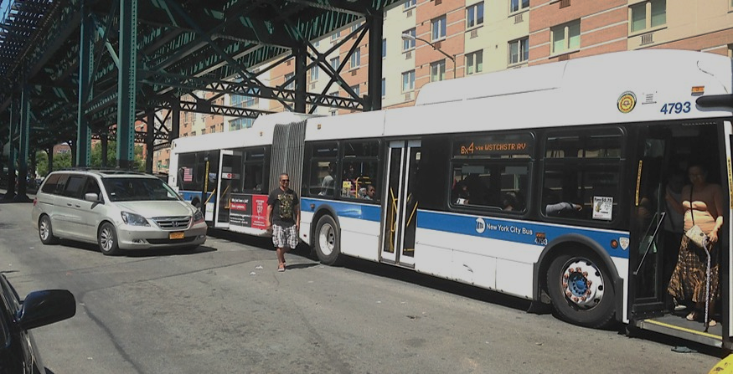
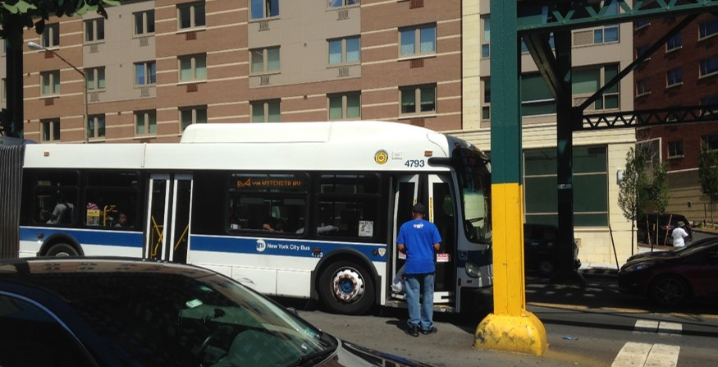
Under the Els
Columns Block Cars’ Visibility of Pedestrians
Issues
Pedestrians are forced to wait, enter and leave the bus in the middle of the street
Turning vehicles weave through the bus stop to make turns or get around a bus
Columns block cars’ visibility of pedestrians
Yellow columns serve as bus stops but no bus stop signs at some locations
Bus Stop in the Middle of the Street
Southern Blvd @ Jennings St
Vehicles in the Service Lane
Passenger
Yellow Column without Bus Stop Sign
Westchester Ave @ 163 St
Passenger
Westchester Ave @ 163 St

Slide 8
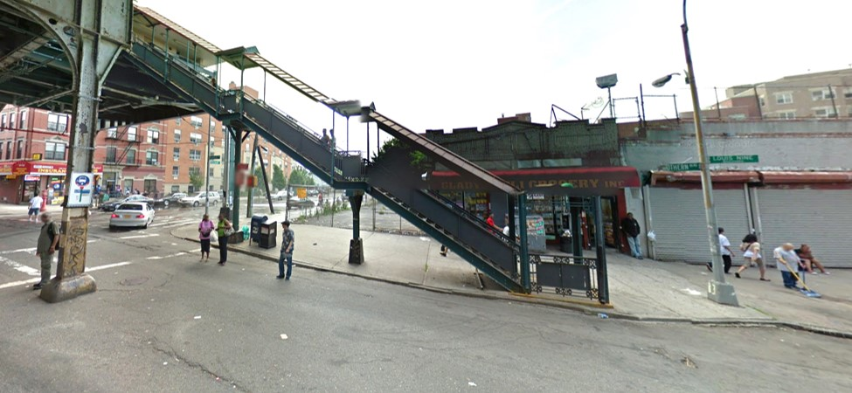
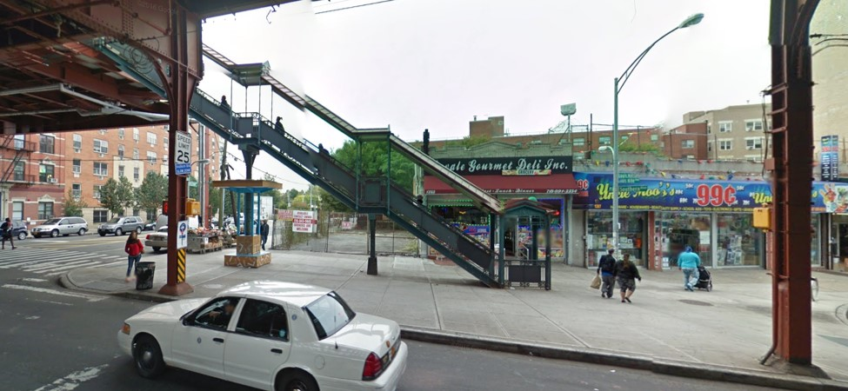
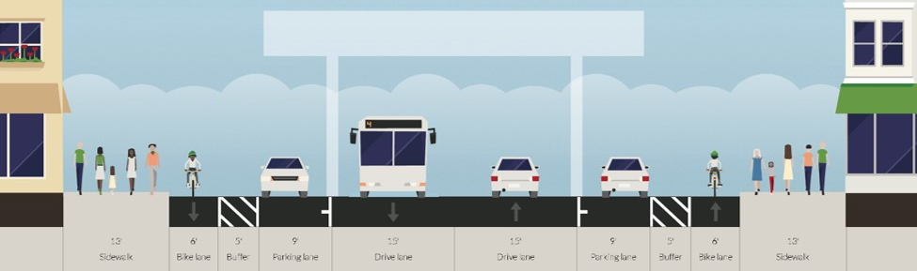
Under the Els
Opportunities
Close outer lanes or add pedestrian island at the bus stops (DOT Bus Stops under the Els)
Pedestrian safety improvement throughout the corridor
Install street furniture at the bus stops under the els
Potential bike lanes (close the current service lanes)
Dangerous Bus Stop/
Service Lane
Southern Blvd @ Freeman St (2011)
Bike Lanes under the Els
Street Furniture at the Bus Stop under the El
Safer Bus Stop with Closed Service and Parking Lanes
5’
Buffer
5’
Buffer
Southern Blvd @ Freeman St (2014)
13’
Sidewalk
6’
Bike Lane
9’
Parking Lane
15’
Travel Lane
15’
Travel Lane
9’
Parking Lane
6’
Bike Lane
13’
Sidewalk
DOT Bus Stops under the Els: http://www.nyc.gov/html/dot/html/pedestrians/safertstransit.shtml#bus

Slide 9
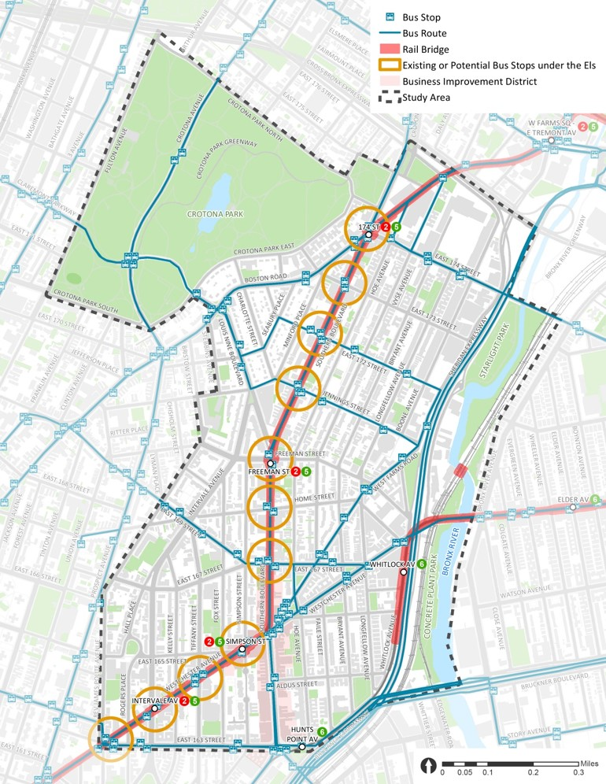
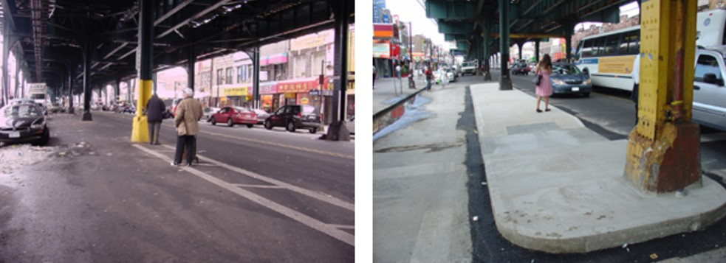
Under the Els
DOT Bus Stops Under the Els Projects
3 completed
Southern Blvd @ Freeman St (Southbound only)
Westchester Ave @ Simpson St (both directions)
1 underway
Southern Blvd @ Boston Rd @ 174 St (construction will begin in Fall 2018 after DDC sewer and water main capital reconstruction)
17 potential
17 more similar bus stops within the study area (possibly be funded by NDF)
Southern Blvd @ Boston Rd @ 174 St
Southern Blvd @ Freeman St (Southbound)
Example of Pedestrian Islands for Bus Stops under the Els at 86th and Bay Parkway in Brooklyn
Westchester Ave @ Simpson St
Before
After
DOT Bus Stops under the Els: http://www.nyc.gov/html/dot/html/pedestrians/safertstransit.shtml#bus

Slide 10
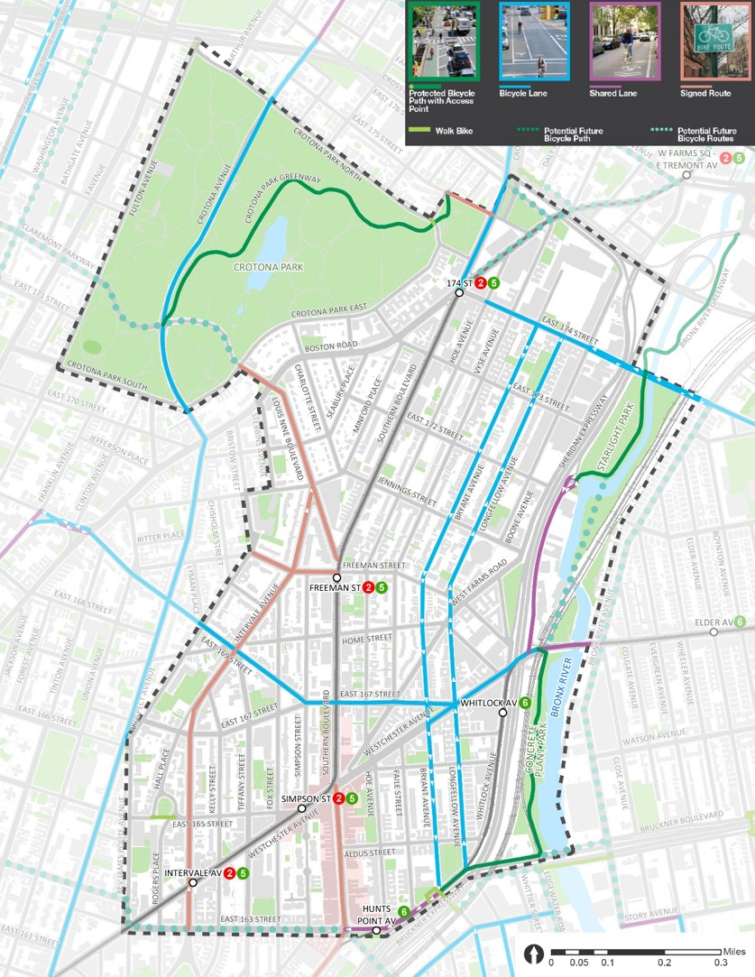
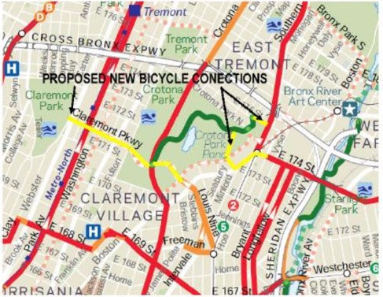
Crotona Park – Connectivity
Bike Connection Opportunities
Background
Crotona & Tremont Park Master Plan 2015 proposed new bike connections
Issues
No wayfinding signage for parks
Bike routes through the park is not connected to the Bronx River
Opportunities
Wayfinding at the subway stations (Freeman St and 174 St)
Better bike connections
Claremont Pkwy – Louis Nine Blvd – Southern Blvd
173 St – Boston Rd – 174 St
175 St
Crotona Pkwy Malls
Claremont Pkwy
175 St
Crotona Park
173 St
174 St
Access Point
Boston Rd
Bryant Ave
Starlight Park
Louis Nine Blvd
Longfellow Ave
Access Point
169 St
Access Point
Southern Blvd
167 St
Concrete Plant Park
Westchester Ave
Access Point
Crotona &Tremont Park Master Plan 2015: https://www.nycgovparks.org/planning-and-building/planning/conceptual-plans/crotona-and-tremont-park-master-plan
10

Slide 11
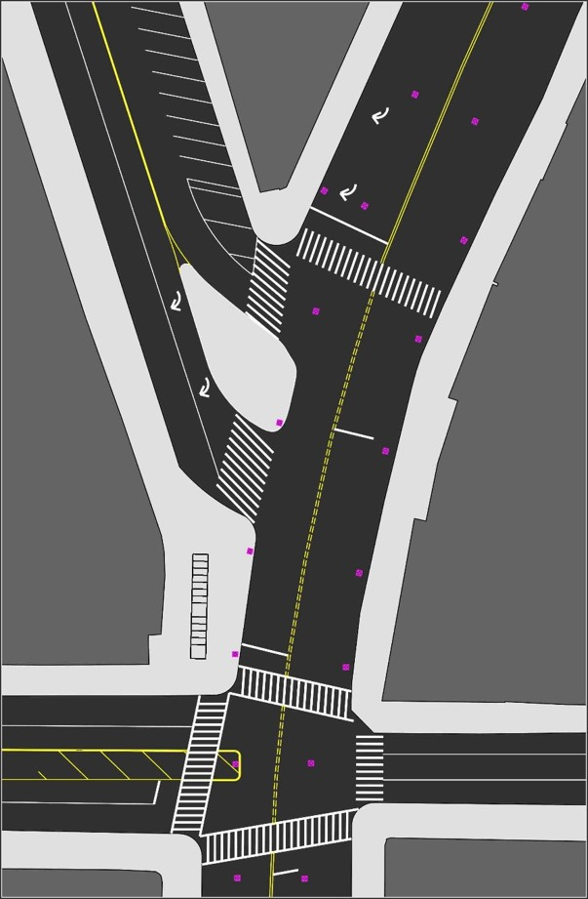
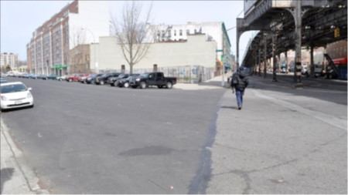
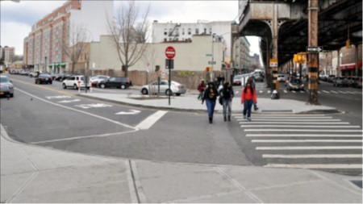
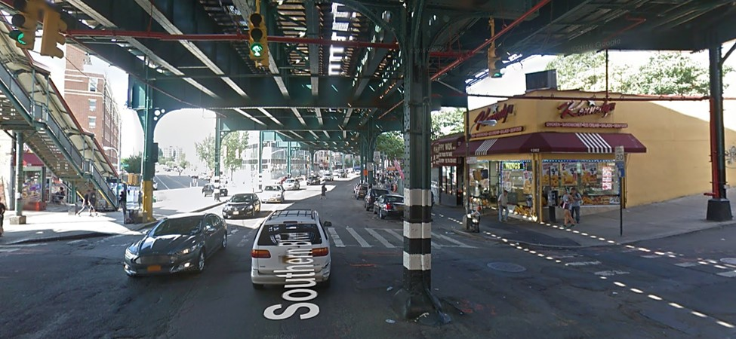
Crotona Park – Louis Nine Blvd Connection
Existing
Southern Blvd
Background
DOT completed project in 2012
15-20% of pedestrians crossing between the two crosswalks on Southern Blvd during the peak hours
Children’s Aid Society new school / community center
Issues
No wayfinding for parks
Long distance between the two crosswalks on Southern Blvd (~200ft)
Louis Nine Blvd
Before DOT Project
Pedestrian Crossing between Two Crosswalks
After DOT Project
Subway Stairs
Bx19
Louis Nine Blvd @ Southern Blvd (Facing North)
Pedestrian Crossing between Two Crosswalks
New School
Southern Blvd @ Freeman St (Facing North)
Louis Nine and Intervale Safety Improvements Project 2012: http://www.nyc.gov/html/dot/downloads/pdf/2012-06-26-louis-nine-cb3-slides.pdf
Louis Nine and Intervale Safety Improvements After Analysis 2013: http://www.nyc.gov/html/dot/downloads/pdf/dot-report-louis-nine-boulevard-bx.pdf
11

Slide 12
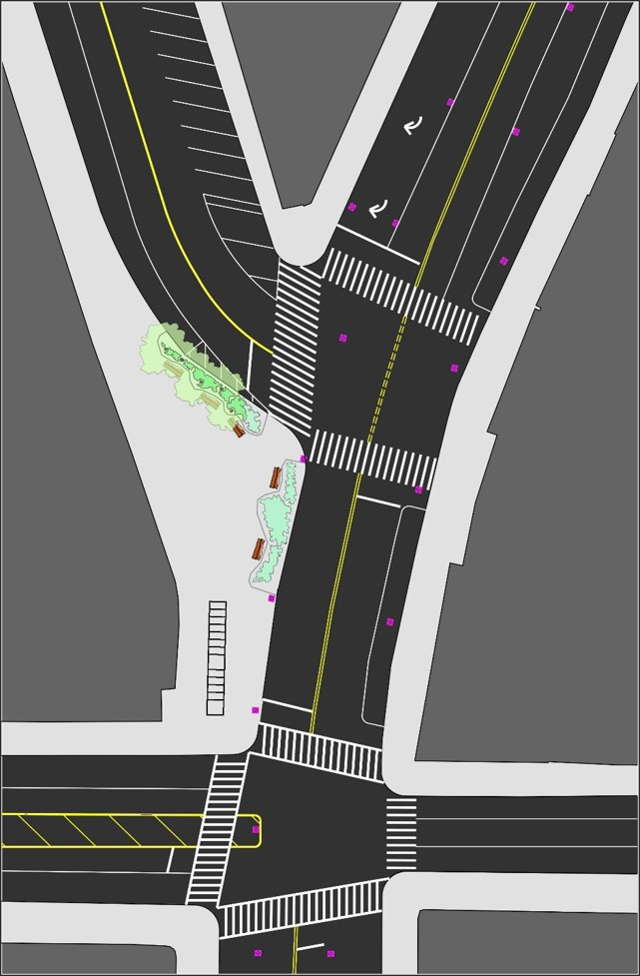
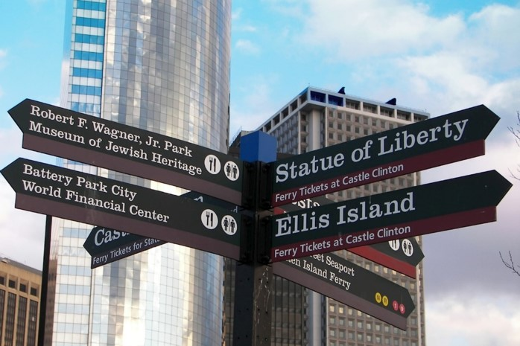
Crotona Park – Louis Nine Blvd Connection
Opportunity
Southern Blvd
Opportunities
Wayfinding signage for parks
In the future, shift pedestrian island to the south side to create a small plaza and use plants to regulate the pedestrian crossings
Louis Nine Blvd
Subway Stairs
Bx19
New School
Wayfinding Signage in Battery Park, Manhattan*
* Source: https://www.smashingmagazine.com/street-and-wayfinding-signs-part-1/
12

Slide 13
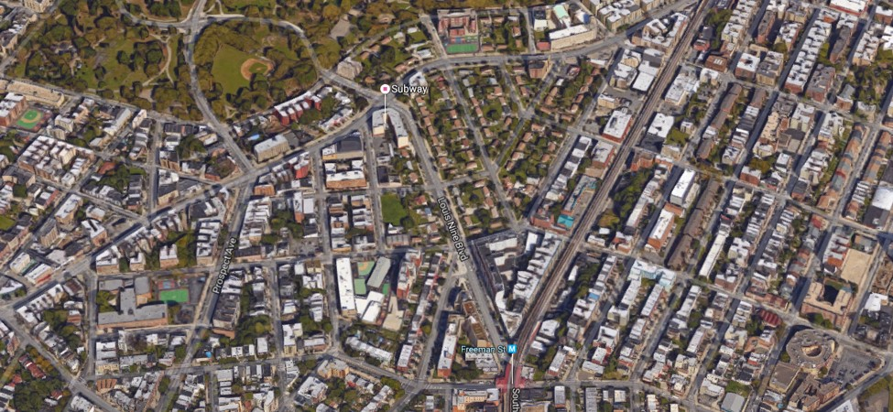
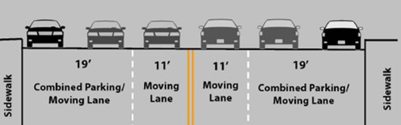
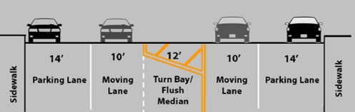
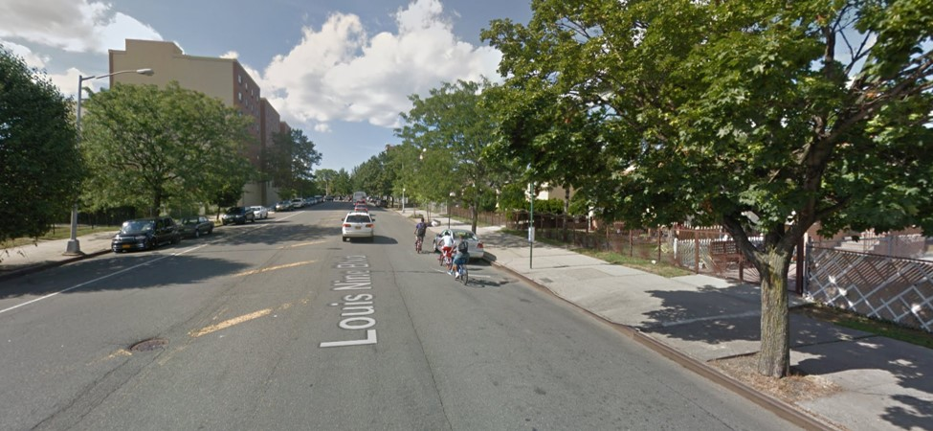
Crotona Park – Louis Nine Blvd Connection
Background
Signed bike route
DOT completed project in 2012
New DOT project: Louis Nine Blvd Safety Improvements (NNLOUISNIN)
Unfunded; $3,125,000; FY2019
Issues
60 feet wide underutilized street
Opportunities
Add standard bike lane by taking 5’ of the 14’ parking lane
Raised median
Crotona Park
Boston Rd
Before
After
170 St
Louis Nine Blvd
Jennings St
2
5
Freeman St Subway Station
Wide On-Street Parking Space
Striped Median
Louis Nine Blvd @ 170 St (Facing North)
Louis Nine and Intervale Safety Improvements Project 2012: http://www.nyc.gov/html/dot/downloads/pdf/2012-06-26-louis-nine-cb3-slides.pdf
Louis Nine and Intervale Safety Improvements After Analysis 2013: http://www.nyc.gov/html/dot/downloads/pdf/dot-report-louis-nine-boulevard-bx.pdf
13

Slide 14
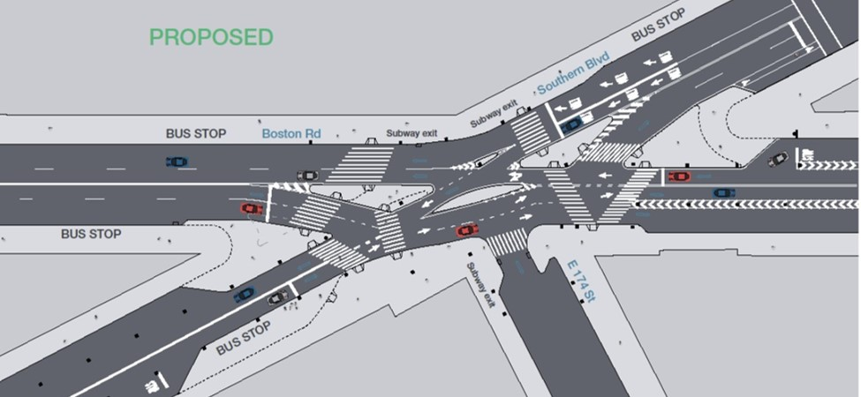
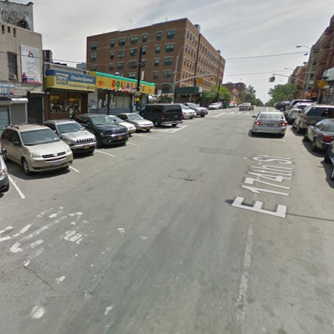
Crotona Park – 174 St Connection
Background
Vision Zero Priority Intersection
DOT project in 2015 (construction will begin in Fall 2018 after DDC sewer and water main capital reconstruction)
Issues
No wayfinding for parks
Bike lane gap on 174 St
Opportunities
Wayfinding signage for parks
Add bike lane on 174 St between Southern Blvd and Hoe Ave
Southern Blvd
Boston Rd
174 St
Bike Lane Gap
Southern Blvd
Bike Lane Gap
Crotona Park
Bike Lane Gap
174 St
One Way
Hoe Ave
Starlight Park
174 St @ Southern Blvd (Facing South)
Southern Blvd & Boston Rd at E174th St Intersection Safety Improvements 2015: http://www.nyc.gov/html/dot/downloads/pdf/2015-03-southern-blvd-boston-rd.pdf
14

Slide 15
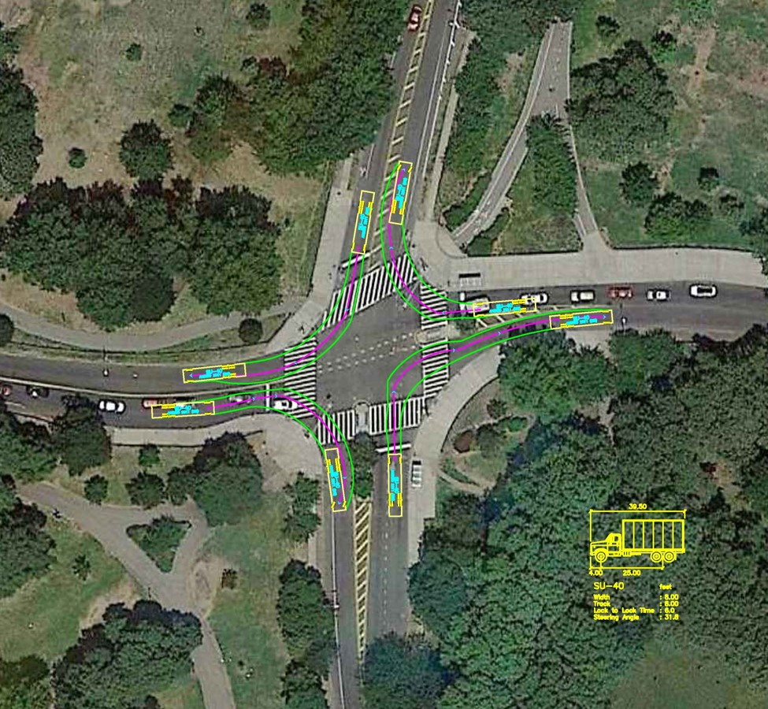
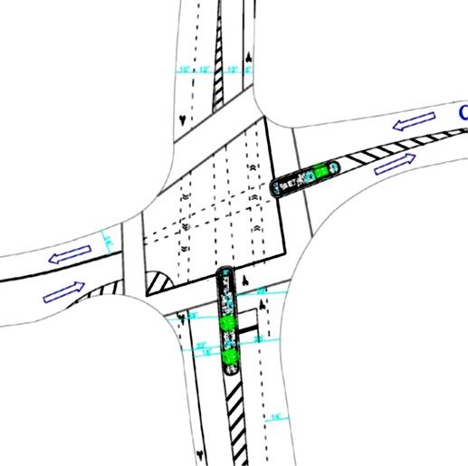
Crotona Park – Crotona Ave @ Claremont Pkwy
Background
Major intersection in the park
Bus stops at four corners
Crotona Ave is the Vision Zero Priority Corridor
37 crashes between 01/01/2010 and 07/31/2016
2010-2014 total KSI was 3; pedestrian KSI was 2
50% of motor vehicle crashes were rear-end collisions
DOT completed project in 2010
Landscaped pedestrian refuges for westbound and northbound
Smaller turning radius for southwest corner
Issues
Large turning radius for southeast corner
Potential speeding issue
Opportunities
Smaller turning radii
Pedestrian island for SB approach
DOT Project
Bus Stop (Bx17)
Bus Stop (Bx11)
Potential Pedestrian Island
Claremont Pkwy
Large Turning Radius
Bus Stop (Bx11)
Bus Stop (Bx17)
Crotona Ave
Proposed in 2010
Crotona Avenue Improvements 2010: http://www.nyc.gov/html/dot/downloads/pdf/20100426_crotona_improvements.pdf

Slide 16
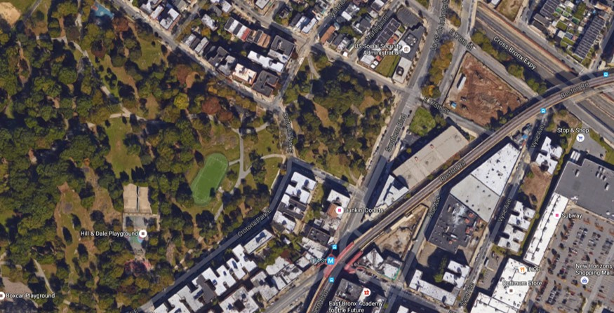
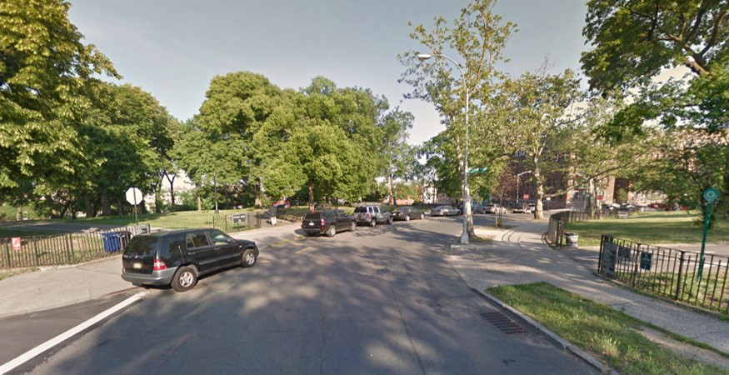
Crotona Park – Crotona Park East
Background
Crotona Park E between Crotona Park N and Crotona Park E is not a mapped Street
Friends of Crotona Park* has suggested closing the segment to better connect Hylan Park and Crotona Park
Issues
Hylan Park is separated from Crotona Park by the unmapped segment
No crosswalk for greenway
No stop sign for Crotona Park E @ Crotona Park N eastbound
Stop sign for Greenway on Hylan Park side but not Crotona Park
Opportunities
Option 1: Close the street (further traffic study needed to see how it would affect traffic flow around the park)
Option 2: Not to close the street but better connect the greenways (stop sign, raised crosswalk, different pavement, etc.)
Option 3: Close the street only on weekends
Crotona Park E
Crotona Park N
175 St
Alternative If Segment Closed
Greenway
No Stop Sign
Stop Sign for Greenway
Hylan Park
Stop Sign
Southern Blvd
Crotona Park
Crotona Park E
Boston Rd
Crotona Park E
174 St
Stop Sign for Greenway
Greenway
Missing Crosswalk
Greenway
Parking Causes Low Visibility
No Stop Sign
Crotona Park E @ Crotona Park N (Facing South)
*Friends of Crotona Park Contact: Shawn Cargil (Shawn.Cargil@parks.nyc.gov)

Slide 17
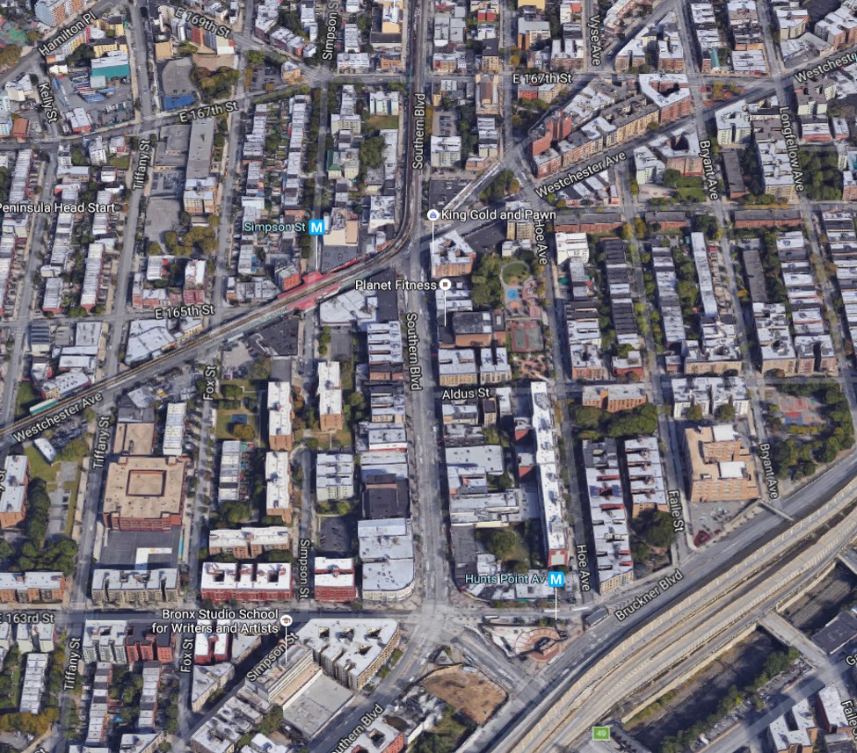
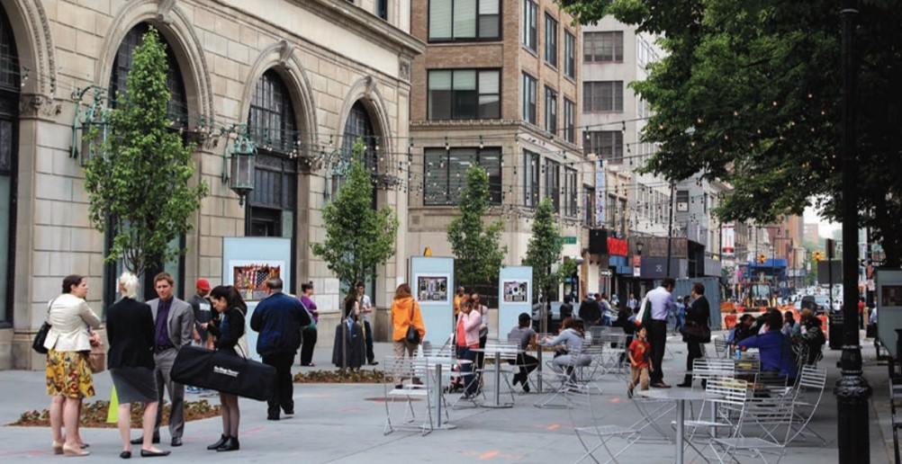
Pedestrian Realm – Southern Blvd BID
Business Improvement District (BID)
Community partners, such as BIDs or civic organizations, can help maintain and program the public open spaces that the City plans and creates with input from the local communities
Public Space Opportunities in Southern Blvd BID
Southern Blvd Retail Corridor
Simpson St Triangle
Monsignor Del Valle Square
167 St
Westchester Ave
Simpson St Triangle
Southern Blvd Retail Corridor
Southern Blvd BID
Southern Blvd
163 St
Monsignor Del Valle Square
Willoughby Plaza in Fulton Mall BID, Brooklyn*
*Source: http://www.nyc.gov/html/dot/downloads/pdf/nycdot-streetdesignmanual-interior-02-geometry.pdf

Slide 18
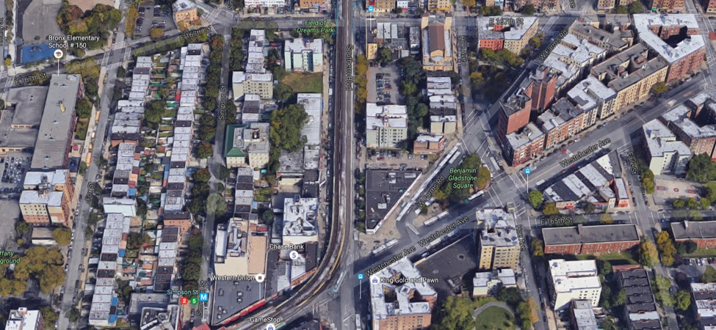
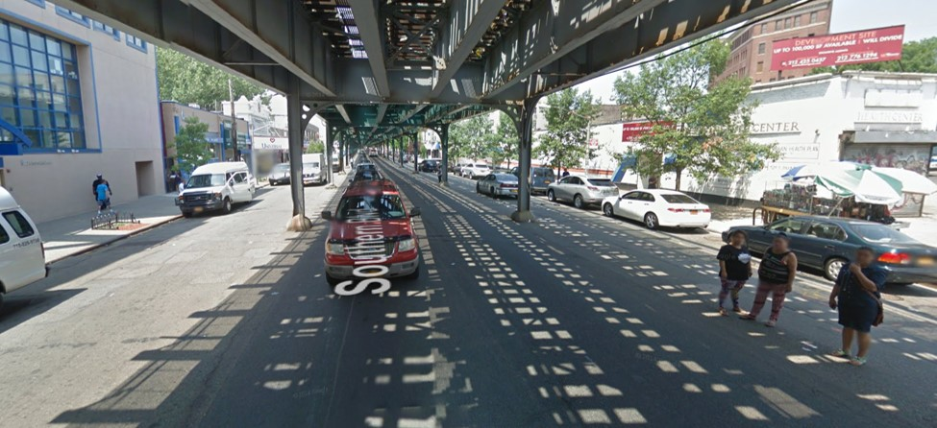
Pedestrian Realm – Southern Blvd Retail Corridor
167 St
Background
Southern Blvd BID
Under the el from 167 St to Westchester Ave
Large vacant lot and parking lot
Issues
Inactive pedestrian retail space
Opportunities
More attractive pedestrian retail space under the el (wider sidewalks, potential bike lanes, etc.)
Vacant Lot
Parking Lot
West Farms Rd
Southern Blvd
Bus Terminal
Southern Blvd BID
Westchester Ave
Simpson St
2
5
Southern Blvd Retail Corridor (167 St – Westchester Ave)
Pedestrian Retail Space Under the El
Southern Blvd between Westchester and 167 St (Facing North)

Slide 19
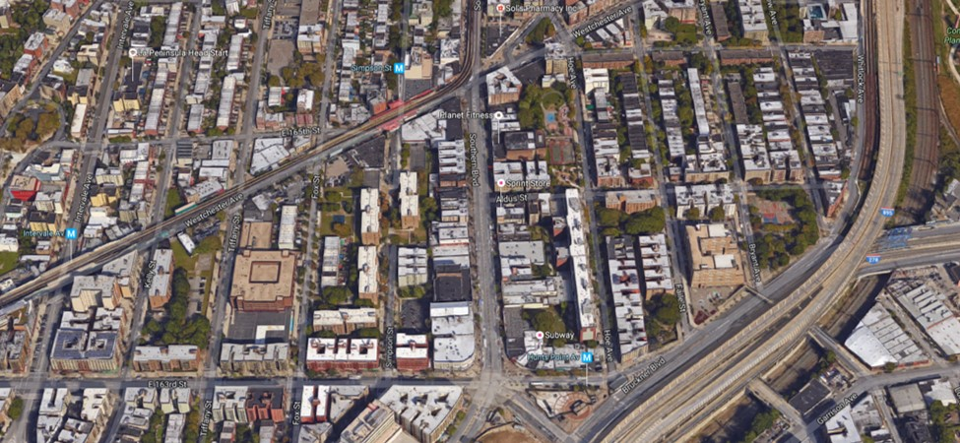
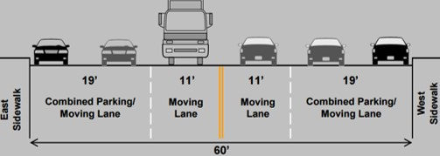
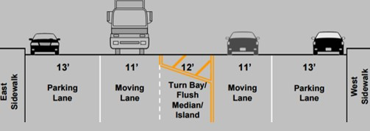
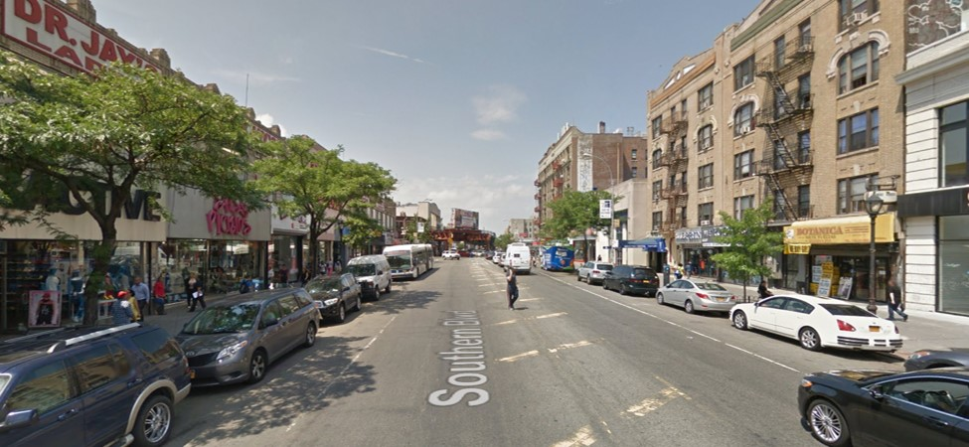
Pedestrian Realm – Southern Blvd Retail Corridor
Bus Terminal
Background
Southern Blvd BID
No el between Westchester Ave and 163 St
Signed bike route
DOT completed project in 2010
Issues
Wide street with striped median
Opportunities
Add standard bike lane by taking 5’ of the 13’ parking lane
Landscaped median
Pedestrian island on south side of the intersection at Aldus St
Street furniture
Simpson St
2
5
Westchester Ave
Aldus St
Southern Blvd
Before
After
Southern Blvd BID
163 St
Hunts Point Ave
6
Southern Blvd Retail Corridor (Westchester Ave – 163 St)
Wide On-Street Parking Space
Striped Median
Southern Blvd between Westchester Ave and 163 St (Facing North)
Southern Boulevard: Crames Square 2010: http://www.nyc.gov/html/dot/downloads/pdf/20100502_crames-sq_cb2.pdf

Slide 20
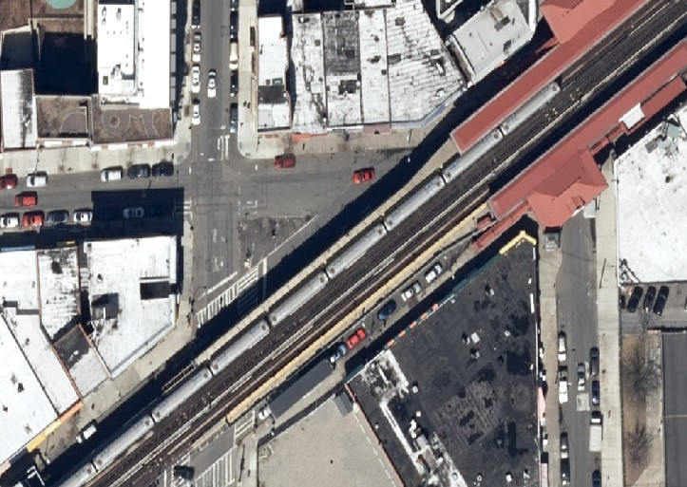
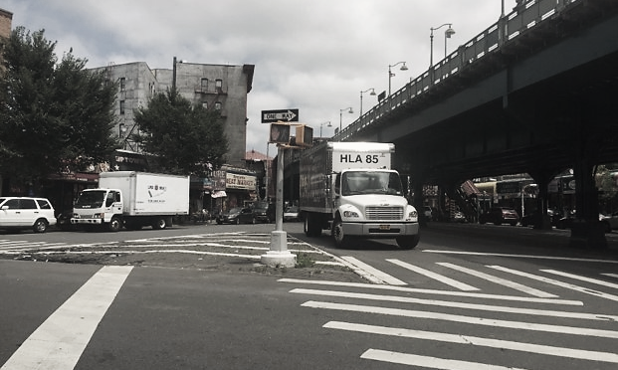
Pedestrian Realm – Simpson St Triangle
Southern Blvd BID
Stair
Background
Southern Blvd BID
Bounded by Westchester Ave, 165 St, and Fox St
Close to Simpson St subway station
Issues
Large empty space
Opportunities
Close 165 St from Westchester Ave to Fox St and create a pedestrian plaza
Simpson St Subway Station
Fox St
2
5
165 St
Southern Blvd BID
Westchester Ave
Stair
Elevator
Southern Blvd BID
Simpson St
Existing
Southern Blvd BID
Stair
Fox St
Simpson St Subway Station
2
5
165 St
Pedestrian Plaza
Southern Blvd BID
Westchester Ave
Stair
Elevator
Striped Empty Space
Southern Blvd BID
Simpson St
Opportunity
Westchester Ave @ Fox St (Facing East)

Slide 21
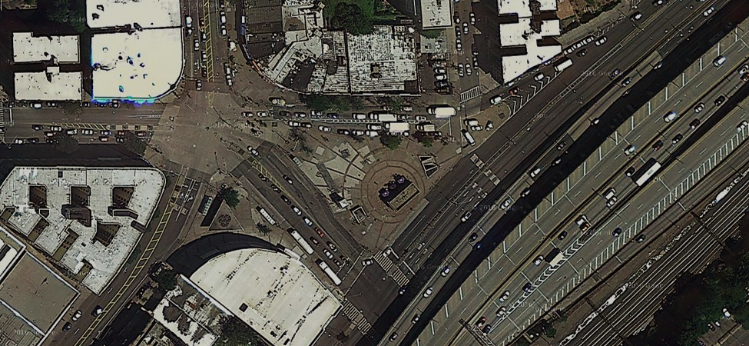
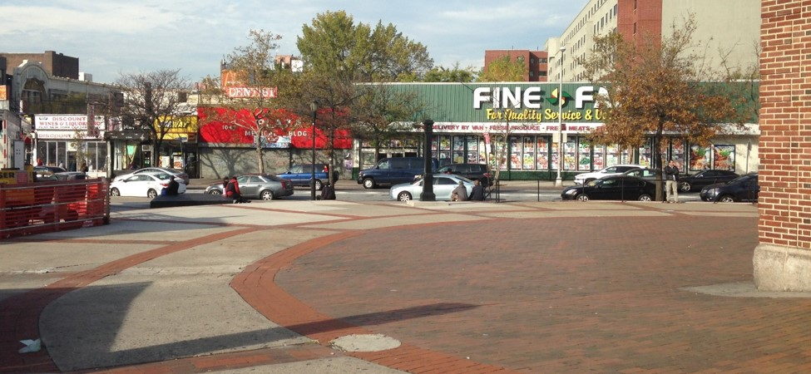
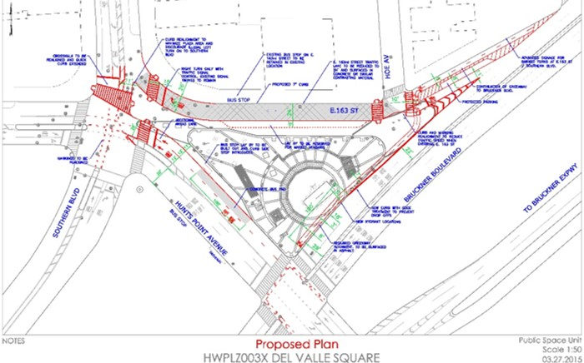
Pedestrian Realm – Southern Blvd BID (Monsignor Del Valle Square)
Background
Southern Blvd BID
Currently maintained by DPR
Transit hub
Subway station with elevator (local and express 6 train)
Bus stops (Bx5,Bx6 and Bx19)
New shopping mall around the plaza
New DOT project: Del Valle Square/Crames Square Traffic, Safety & Plaza Improvements (P-102DELV)
Funded; $13,927,000; FY18
The project will reconfigure the roadway at Bruckner Boulevard, Hunts Point Avenue and East 163rd to create a new public plaza and enhance pedestrian safety.
Issues
Underutilized
plaza space
Opportunities
Trees
Street furniture
Maintained by BID
Southern Blvd BID
Southern Blvd BID
Hoe Ave
Bx5
163 St
Bx6
Monsignor Del Valle Square
6
Bx19
Bx19
Bx5
Southern Blvd BID
6
Bruckner Blvd
Hunts Point Ave
Bx6
New Shopping Mall
Southern Blvd
Underutilized Plaza Space
Monsignor Del Valle Square / Crames Square
DOT Conceptual Design for Del Valle Plaza (2015)*
*Geometry may change following traffic study

Slide 22
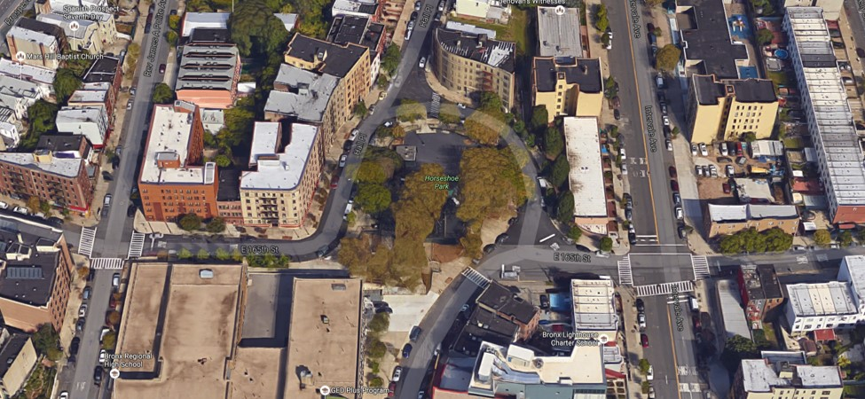
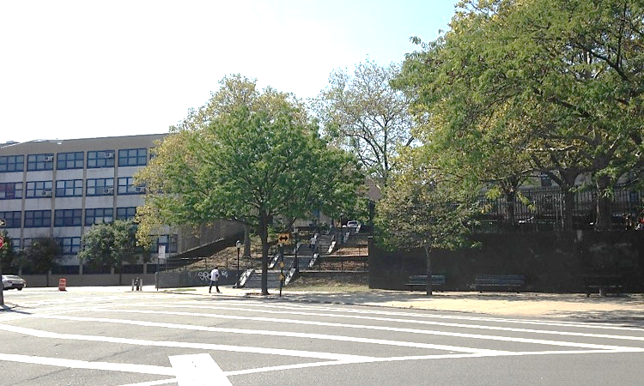
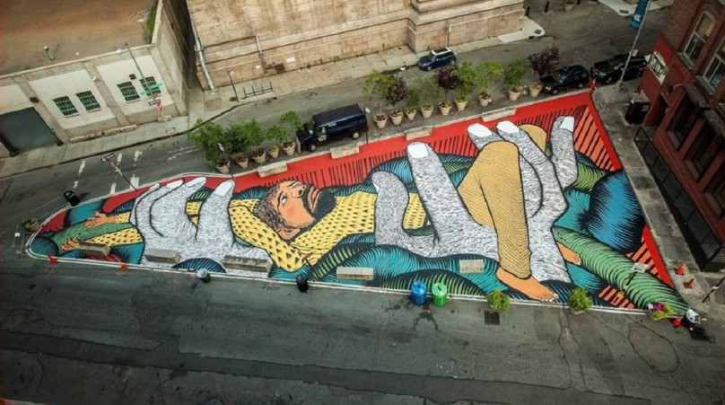
Pedestrian Realm – Horseshoe Park Triangle
Hall Pl
Background
Horseshoe Park with step street
Schools around the park
Issues
Large empty striped space
Opportunities
School maintained public art or murals
Intervale Ave
Horseshoe Park
Stop Sign
Step Street
165 St
Stop Sign
School
Rogers Pl
School
Playground
Step Street
Benches
Large Empty Striped Space
Rogers Pl @ 165 St (Facing West)
David Ellis’s Mural in Pearl Street Triangle in Brooklyn*
*Source: http://www.pbs.org/newshour/updates/urban-designers-transformed-these-five-plazas-into-pedestrian-paradise/

Slide 23


Westchester Ave
Under the el from 163 St to Southern Blvd
70 ft. wide street without el from Southern Blvd to Whitlock Ave
High crashes along Westchester Ave
High pedestrian crashes at the intersection of Westchester Ave and Southern Blvd
Crash 2010-2014
KSI* 2010-2014
**
Westchester Ave (163 St to Whitlock Ave)
Crashes | 2010-2014
Total | 290
Pedestrian | 81
Bicycle | 20
KSI* | 2010-2014
Total | 19
Pedestrian | 5
Bicycle | 4
Westchester Ave
Westchester Ave
*KSI = Number of Killed or Severely Injured persons in crashes
**DOT uses pedestrian KSI to identify Vision Zero Priority Intersections, Corridors and Areas

Slide 24


Westchester Ave – 163 St / Rev James A Polite Ave
163 St
Truck Route
Background
Westchester Ave and 163 St are truck routes
48 crashes between 01/01/2010 and 07/31/2016
5 bus-involved crashes and 3 truck-involved
8 collisions with fixed object, structure or barriers, including 4 happened at night
Issues
Columns in the middle of the intersection (unclear which side of columns to drive on)
Downhill may cause speeding
Opportunities
Lane assignments for southbound (exclusive left turn)
Markings to guide the vehicles
162 St
165 vph (PM Peak)
13
163 St
Truck Route
Bx6
23
342
79
Westchester Ave
Rev James A Polite Ave
Issues
Opportunities
Bx6
Columns
Buses
Rev James A Polite Ave
163 St (Inner)
163 St (Outer)
Westchester Ave
Westchester Ave
162 St
Left Turn Only
Opportunities for Southbound Lane Assignments
Downhill

Slide 25


Westchester Ave – Southern Blvd
Bx11/Bx27/Bx35/Bx4/Bx4A
Two Lanes for Each Direction
Background
Transit Hub
Simpson St subway station (2/5 train)
Bus Terminal (Bx11/Bx27/Bx35)
Bus Stops (Bx4/Bx4A/Bx5/Bx19)
Southern Blvd BID
55 crashes between 01/01/2010 and 07/31/2016
55% were pedestrian and bike crashes (26 pedestrian crashes and 4 bike crashes)
2010-2014 total KSI was 6; pedestrian KSI was 2
4 bus crashes and 3 truck crashes
Issues
Columns in the middle of the intersection
85 feet long pedestrian crossing
Westbound merging from two lanes to one lane
Opportunities
Curb extensions to shorten the long pedestrian crossings
Markings and signs to guide the vehicles
Southern Blvd
85 Feet Long Pedestrian Crossing
Bx4/
Bx4A
Column
Column
One Lane for Each Direction
Bx5/Bx19
Simpson St
Southern Blvd BID
2
5
Westchester Ave
Bx5/Bx19
Column
Column
85 Feet Long Pedestrian Crossing
Southern Blvd @ Westchester Ave (Facing West)

Slide 26

Westchester Ave – Southern Blvd
Left Turns
Through Movements
Bus Terminal
Bus Terminal
Merge Sign
Dotted Lines to Guide Vehicles
Bx4/Bx4A
No Parking
Bx4/Bx4A
Signs on the Columns to Guide Left Turns
Parking / Double Parking
Curb Extensions
Bx5/
Bx19
Bx5/
Bx19
Merge Marking
Westchester Ave
Westchester Ave
Southern Blvd
Southern Blvd
Bx5/
Bx19
Issues
Bx5/
Bx19
Issues
Opportunities
Opportunities

Slide 27


Westchester Ave – West Farms Rd Bus Terminal
Background
Bus Terminal (Bx11/Bx27/Bx35)
Bus Stop (Bx4/Bx4A)
Issues
Buses inch out and turn left at the unsignalized intersection
Opportunities
Option 1: Add a traffic signal coordinated with the signal timing of Westchester Ave @ Southern Blvd
Option 2: Reverse the loop direction
Option 3: Signal timing modifications for the signals at Westchester Ave @ Southern Blvd and Westchester Ave @ Hoe Ave to create gaps for buses turning left
Hoe Ave
West Farms Rd
Southern Blvd
Westchester Ave
Bx11/Bx27/Bx35
Bx4/Bx4A
Traffic Signal
No Traffic Signal
Simpson St Subway Station
Traffic Signal
2
5
Left Turn at the Unsignalized Intersection
West Farms Rd @ Westchester Ave

Slide 28



Westchester Ave – Hoe Ave
Background
20 crashes between 01/01/2010 and 07/31/2016
85% were pedestrian and bike crashes (14 pedestrian crashes and 3 bike crashes)
50% happened when the motor vehicles were making left turns
Bx5 (articulated) uses the slip to turn around
Issues
70-75 feet long pedestrian crossing
Opportunities
Curb extensions on Westchester Ave to shorten the long pedestrian crossings
Left turn safety treatments (bollards, signal timing modification, etc.)
Westchester Ave
Southern Blvd
West Farms Rd
70 Feet Long Pedestrian Crossing
75 Feet Long Pedestrian Crossing
165 St
Bx5
Hoe Ave
Westchester Ave
Curb Extensions
West Farms Rd
Hoe Ave
165 St
Curb Extension Opportunities
Example of Left Turn Traffic Calming Pilot
DON’T CUT CORNERS LEFT TURN Pedestrian & Bicyclist Crash Study 2016: http://www.nyc.gov/html/dot/downloads/pdf/left-turn-pedestrian-and-bicycle-crash-study.pdf

Slide 29



Westchester Ave – Longfellow Ave / 167 St
Background
35 crashes between 01/01/2010 and 07/31/2016
29% were pedestrian crashes
60% of all crashes were motor vehicle crashes, within which 38% were rear end collisions
Issues
78-86 feet long pedestrian crossing
Pedestrian signal blocked by streetlight pole
Opportunities
Ban the right turn from 167 St to Westchester Ave
Curb extensions to shorten the long pedestrian crossings
Adjust the position of pedestrian signal
Bryant Ave
Blocked Pedestrian Signal
Westchester Ave
78 Feet Long Pedestrian Crossing
85 Feet Long Pedestrian Crossing
167 St
86 Feet Long Pedestrian Crossing
Longfellow Ave
78 Feet Long Pedestrian Crossing
85 Feet Long Pedestrian Crossing
Pedestrian Signal Blocked by Streetlight Pole
86 Feet Long Pedestrian Crossing
Westchester Ave @ 167 St (Facing East)
167 St @ Westchester Ave (Facing East)

Slide 30


Westchester Ave – Longfellow Ave / 167 St
Existing
Opportunity
78
45
86
56

Slide 31


Westchester Ave – Whitlock Ave
Proposed Improvements in 2013 Project
Background
44 crashes between 01/01/2010 and 07/31/2016
4 bicycle crashes, 3 pedestrian crashes, 3 bus crashes and 5 truck crashes
15 crashes were either overtaking or rear end and 6 of them were overtaking while going straight ahead towards south
DOT completed project in 2013
New DOT project: Westchester Avenue and Whitlock Avenue Pedestrian Safety Improvements (NN-XWHIT)
Unfunded; $4,375,000; FY20
Issues
Potential speeding issue
No clear markings on Whitlock Ave
Opportunities
Markings to guide vehicles on Whitlock Ave
Speed limit signs
Enforcement
Faded / Not Done
Whitlock Ave @ Westchester Ave (Facing North)
Bronx River Greenway Southern Connections 2013: http://www.nyc.gov/html/dot/downloads/pdf/2013-01-bronx-river-greenway-cb2.pdf

Slide 32


Additional Opportunities – Cross Bronx Plaza
Cross Bronx Plaza
Background
Neighborhood shopping mall
2/3 of parking lot is utilized on both weekday AM and Saturday afternoon
Issues
Not well oriented to pedestrians who likely approach on 174th St from the 2/5 subway station to the west
Limited bus choices for neighborhood in the south to access the plaza
Opportunities
Signage/wayfinding
Bus shelters/benches (sidewalk width: 14’8’’; 5’ for shelter and 7’ for min clear path)
Better north-south bus connections for the plaza
Cross Bronx Plaza
Vyse Ave
Underutilized Parking Spaces
2
5
Exit
Boone Ave
36
Bus Stop (Bx36)
Eae J Mitchell Park
Entrance
Bryant Ave
Longfellow Ave
174 St

Slide 33




Additional Opportunities – Intervale Ave
Freeman St
Background
Signed bike route
DOT completed project in 2015
Issues
Wide underutilized street
Opportunities
Add standard bike lane by taking 5’ of the 14’ parking lane
Raised median
Intervale Ave
169 St
Intersection Improvement
Home St
Before
Pedestrian Island
167 St
Mid-block Pedestrian Island
Pedestrian Island
165 St
After
Westchester Ave
Pedestrian Island
Intersection Improvement
Wide On-Street Parking Space
Striped Median
Intervale Ave @ 165 St (Facing North)
Intervale Avenue Traffic Calming and Pedestrian Safety 2015: http://www.nyc.gov/html/dot/downloads/pdf/2015-02-intervale-ave.pdf

Slide 34



Additional Opportunities – 167 St @ Vyse Ave @ West Farms Rd
School
Bx11
Background
Two phases for signal timing
AM Peak (7:45-8:00)
2 vehicles for right turn from West Farms Rd to Vyse Ave
36 pedestrian crossings on Vyse Ave
PM Peak (17:30-17:45)
4 vehicles for right turn from West Farms Rd to Vyse Ave
25 pedestrian crossings on Vyse Ave
Issues
No pedestrian signal on Vyse Ave
West Farms Rd southbound stop line too far from intersection
Opportunities
Restrict right turn from West Farms Rd to Vyse Ave
Curb extension
Move stop line closer to the intersection
Add pedestrian signal
Vyse Ave
Stop Line Too Far from Intersection
Bryant Ave
No Pedestrian Signal
167St
West Farms Rd
Stop Line Too Far from Intersection
No Pedestrian Signal
West Farms Rd @ Vyse Ave (Facing South)
Opportunity

Slide 35
appendix existing conditions

Slide 36


Land Use
Land Use & Zoning
Building Height

Slide 37

Commuting Characteristics (Residents)
Commuting Flow (2010)
Mean Travel Time to Work: 42.7 mins (2014)
Means of Transportation to Work (2014)
Vehicles Available (2014)
Means of Transportation to Work | Percentage
Car, Truck, or Van | 18%
Drove Alone | 15%
Carpooled | 3%
Public Transportation | 70%
Bus | 21%
Subway | 49%
Bicycle | 1%
Walked | 7%
Other Means | 1%
Worked at Home | 3%
Crotona Park East
Hunts Point
Midtown-Midtown South
Vehicles Available | Percentage
No vehicle available | 59%
1 vehicle available | 29%
2 vehicles available | 11%
3 or more vehicles available | 1%
Battery Park City-Lower Manhattan
Source: ACS 2010-2014; CTPP 2006-2010

Slide 38

Subway
2/5 Train
Intervale Ave (Escalator)
Simpson St (Elevator)
Freeman St
174 St
6 Train
Hunts Point Ave (Elevator)
Whitlock Ave
Subway Station | Annual Ridership (2010) | Annual Ridership (2015) | % Change (2010-2015) | Weekday Average Ridership (2015) | Weekend Average Ridership (2015)
Intervale Ave (2/5) | 908,596 | 1,039,265 | 14% | 3,472 | 1,416
Simpson St (2/5) | 3,057,192 | 3,048,014 | 0% | 9,981 | 4,617
Freeman St (2/5) | 1,332,285 | 1,492,757 | 12% | 4,899 | 2,232
174 St (2/5) | 2,239,254 | 2,313,651 | 3% | 7,619 | 3,399
Hunts Point Ave (6) | 3,248,970 | 3,305,563 | 2% | 10,484 | 5,835
Whitlock Ave (6) | 163,461 | 545,079 | 233% | 1,737 | 932

Slide 39
Bus
Bx4/4A (The Hub ⬄ Westchester Square)
Bx5 (Pelham Bay Park ⬄ Hunts Point)
Bx6 (Hunts Point, Bronx ⬄ Washington Heights, Manhattan)
Bx11 (Longwood, Bronx ⬄ GW Bridge Bus Station, Manhattan)
Bx17 (Mott Haven ⬄ Fordham Plaza)
Bx19 (NY Botanical Garden, Bronx ⬄ Riverbank State Park, Manhattan)
Bx21 (Westchester Square ⬄ Mott Haven)
Bx27 (Clasons Point ⬄ Soundview or Hunts Point)
Bx35 (Hunts Point, Bronx ⬄ Washington Heights, Manhattan)
Bx36 (Soundview, Bronx ⬄ Washington Heights, Manhattan)
Rank | Bus Stop | Daily Boarding + Alighting (2015)
1 | HUNTS POINT AV/E 163 ST (BX6) | 4,103
2 | W FARMS RD/WESTCHESTER AV (BX35) | 2,734
3 | E 163 ST/HOE AV (BX5) | 2,674
4 | W FARMS RD/HOE AV (BX27) | 2,672
5 | SOUTHERN BL/E 174 ST (BX19) | 1,982
6 | HUNTS POINT AV/SOUTHERN BL (BX5) | 1,976
7 | E 174 ST/BRYANT AV (BX36) | 1,974
8 | SOUTHERN BL/HUNTS POINT AV (BX19) | 1,787
9 | SOUTHERN BL/E 163 ST (BX19) | 1,685
10 | W FARMS RD/WESTCHESTER AV (BX27) | 1,667

Slide 40
Transit Hub
Simpson St Transit Hub
Subway: 2/5 Train
Bus Terminal: Bx5, Bx11, Bx27, Bx35
Bus Stop: Bx4/4A, Bx19
Hunts Point Ave Transit Hub
Subway: 6 Train
Bus Stop: Bx5, Bx6 (SBS in progress), Bx19
West Farms Sq Transit Hub (just outside of study area)
Subway: 2/5 Train
Bus Terminal: Bx9
Bus Stop: Bx21, Bx36, Bx40, Bx42, Q44

Slide 41


Bicycle
Future / New Bike Connections
Starlight Park / Bronx River Greenway
Del Valle Square Path / South Bronx Greenway (continuous two-way path along Bruckner Boulevard from Bronx River Ave to East 133rd Street)
Pedestrian Bridge
Bronx River Greenway
Starlight Park Phase II
Del Valle Square Path
South Bronx Greenway (Completed)
Starlight Park / Bronx River Greenway
Del Valle Square Path / South Bronx Greenway
South Bronx Greenway
Bruckner Boulevard – Hunts Point Safety Improvements: http://www.nyc.gov/html/dot/downloads/pdf/2015-03-bruckner-blvd.pdf

Slide 42

Truck
Through Truck Route
Cross Bronx Expy
Bruckner Expy
Sheridan Expy (planned to be transformed into a neighborhood boulevard to better connect the neighborhood and the Bronx River waterfront*)
Local Truck Route
Southern Blvd
Under the El between Boston Rd and Westchester Ave
Boston Rd
Under the El between Southern Blvd and Cross Bronx Expy
Westchester Ave
Under the El between Southern Blvd and 163 St + between Whitlock Ave and Bronx River Ave
Whitlock Ave
Under the El between Westchester Ave and Aldus St
163 St
West Farms Rd – Boone Ave
Bruckner Blvd
Hunts Point Ave
Planned Crossing to the Waterfront
Planned Crossing to the Waterfront
Sheridan Expy NB Entrance
Planned Crossing to the Waterfront
Sheridan Expy SB Exit
Sheridan Expy NB Exit
Bruckner Expy SB Exit
Sheridan Expy NB Entrance
*Sheridan-Hunts Point Land Use and Transportation Study: http://www1.nyc.gov/site/planning/plans/sheridan-hunts-point/sheridan-hunts-point.page

Slide 43


Vision Zero
Street Design
Priority Intersections, Corridors & Areas

Slide 44

DOT Capital Projects
Construction
Southern Blvd & Boston Rd at E 174th St Intersection Safety Improvements (construction will begin in Fall 2018 after DDC sewer and water main capital reconstruction)
Safe Route to Transit (HWSRT200C; FY16)
Sandy Phase II Resurfacing (SAND349FM; FY16)
Funded
South Bronx East-West Crosstown SBS (HWX100SBC; FY18)
Del Valle Square/Crames Square Traffic, Safety & Plaza Improvements (P-102DELV; FY18)
Underfunded
Bronx Highways and Parkways E 174th St (2066720; FY19; not proceeding)
Bronx Highways and Parkways Bruckner Expwy Sb (2075351; FY36; proceeding)
Multi-Site Pedestrian Safety (HWPEDSF4; FY17)
Unfunded
Louis Nine Blvd Safety Improvements (NNLOUISNIN; FY19)
Safety Improvements on Intervale Ave at Dawson St & E169th St (NNINTERDAW; FY19)
Safety Improvements on Prospect Ave at Dawson/Ave St. John/Rev Polite Ave (NNPROSPECT; FY19)
Westchester Avenue and Whitlock Avenue Pedestrian Safety Improvements (NN-XWHIT; FY20)
Bronx Highways and Parkways 174th St-nth Ped Brdg (206672A; FY26)
Bronx Highways and Parkways 174th St-sth Ped Brdg (206672B; FY27)
Westchester Ave (2240180; FY25)
Bronx Highways and Parkways Bruckner Expwy (2076929; FY24)
Bronx Highways and Parkways Bruckner Expwy Nb (2066672; FY23)
1
13
14
6
9
3
10
12
15
11
2
8
7
16
17
4
10
5

Slide 45

Traffic Counts
Proposed Turning Movement Counts (TMC)
Claremont Parkway @ Crotona Ave
Louis Nine Blvd @ Boston Rd
Southern Blvd @ Freeman St @ Louis Nine Blvd
Southern Blvd @ Westchester Ave
172 St @ Vyse Ave
Westchester Ave @ Longfellow Ave @ 167 St
Westchester Ave @ Whitlock Ave
Westchester Ave @ Hoe Ave
Proposed Automatic Traffic Recorders (ATR)
Crotona Park East between Crotona Park North and Crotona Park East
Louis Nine Blvd between Jennings St and 170 St
Southern Blvd between Freeman St and Home St
165 St between Fox St and Westchester Ave
Westchester Ave between Southern Blvd and Simpson St
Westchester Ave between Intervale Ave and Kelly St
9
1
2
8
10
3
11
7
6
5
4
12
13
14

